Slide 1
Programming and Algorithm
Lab 3: Basic Programming(Operator)

Slide 2
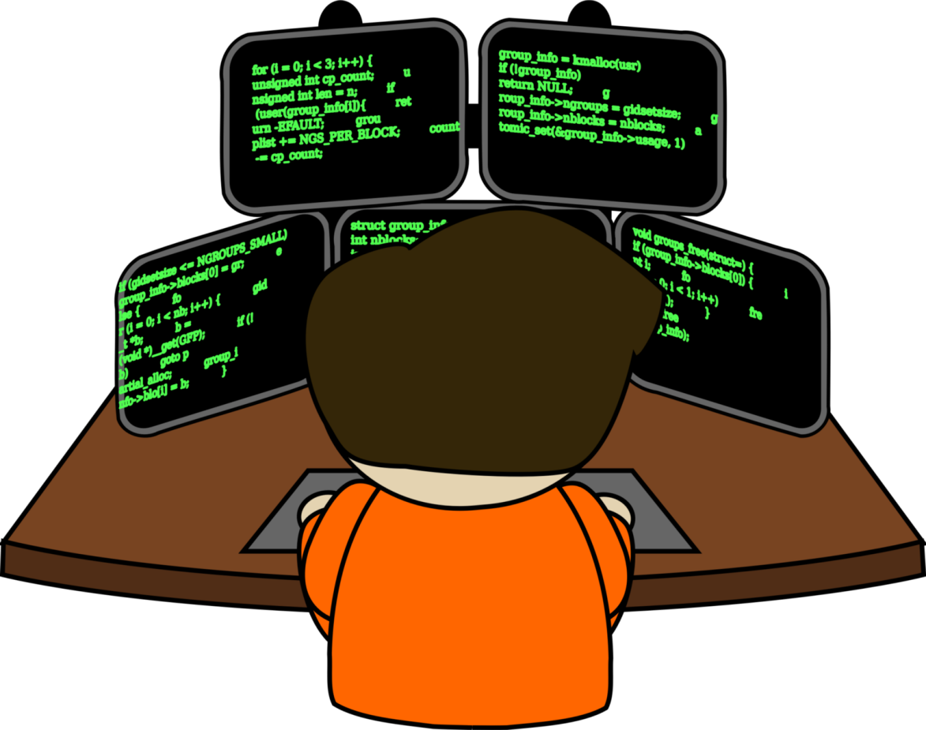

Welcome to Basic Programming Class

Slide 3

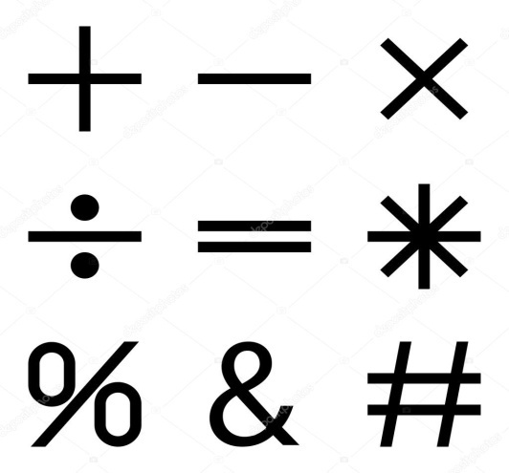
What is Operator?
An operator is a symbol that tells the compiler to perform specific mathematical or logical functions.
Such as + , - , /

Slide 4
Operator Classifications.
Arithmetic Operators
Relational Operators
Logical Operators

Slide 5
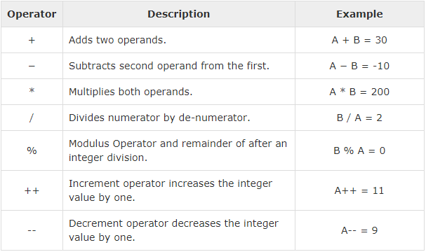
Arithmetic Operators

Slide 6
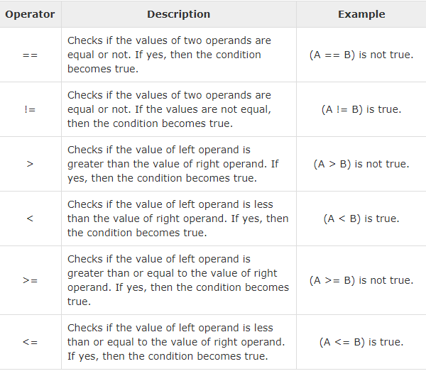
Relational Operators

Slide 7
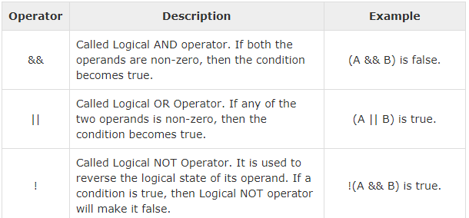
Logical Operators

Slide 8

Today’s learning:
Arithmetic Operators
Relational Operators
Logical Operators
Thank You!

